Slide 1
Machine Learning in WAN Research
Oct 2017
Presented at Internet2 TechEx 2017
Mariam Kiran
mkiran@es.net
Energy Sciences Network (ESnet)
Lawrence Berkeley National Lab

Slide 2
Outline
ML in general
ML in network research
Literature Review of research from [2010 - Sept 2017] of ML algorithms in WANs
Common areas, data involved, what problems solved
Road Ahead (unexplored areas)
Notes:
Identify areas to work on
Relevance to networking
Ongoing work…

Slide 3
AI, ML, DL – What’s the Difference?
Courtesy Nvidia Blog
Turing “Can Machines Think” – Turing Test : Exhibit human-like intelligence
Machine learning is collection of algorithms that can help achieve AI
e.g spam filters, HR hiring, etc
Deep learning is one of these ML techniques
Recent advances due to GPU and HPC processing (previously very slow, too much data, need training to work)
Mainly for image and speech recognition – commercial apps
Notes:
Imagine this scenario:
Dedicated links with specific QoS and are scheduled
Various actors involved: Scientists->network engineers->IT->Scientists
Manual provisioning
Gathering requirements – understanding and communication
Moving large files to certain endpoints
Make sure they have arrived in time

Slide 4
AI Tree (example techniques) only a subset are ML algorithms
Evolutionary algorithms (Genetic algorithms, evolutionary strategies, etc)
Optimization technique
Swarm intelligence (ant colony, etc)
Networks : graph algorithm (routing – shortest path)
Expert systems
AI
ML: Where ever training or ‘learning’ on statistical data
Fuzzy systems
Convolutional networks
Neural Networks
Deep belief networks
Deep boltzman networks
Stacked autoencoders
Random Forrest, Clustering, etc
Many more….
Notes:
Graph based search algorithm (routing algo – shortest path, distance vector- bellman-ford, ford-fulkinson)

Slide 5
Algorithms chosen depending on
data available
problem being solved
combining multiple techniques
(some 50% accuracy, others 80% accuracy)

Slide 6
Example: Choosing Algorithms for Problems (e.g. deep learning or DNNs)
Deep neural network | Input Data | Applied for | Variants
Feed forward neural network | Hierarchical data representations | General classification Clustering Anomaly finding Feature extraction | Deep belief networks (uses restricted boltzman machine for activation function) Convolutional neural networks
Recurrent neural network | Sequential data representation (i.e. time series data) | Sequential learning | Long short term memory (LTSM) used for speech translation
There are many variants of DNNs. Papers and researchers in each specific DNN.
DeepMind used Deep Q-learning for Attari and Go
Action-pairs based on learned data.
Notes:
Deep Q-learning and reinforcement learning have shown successes in training computers to play games with available action plans [42].
Various variants of the deep neural network have been introduced in literature [Fukishomo, etc]. Each have been devised to best suit the data and behavior they are learning (Table 1). Feed forward neural network use differentiable functions to set local neuron weights, whereas, recurrent neural network cycle back weights dynamically to train in a temporal way. Both algorithms have shown considerable progress in kinds of problems being investigated.
Training the neural network is an essential part of the algorithm. Some use a minimizing loss equation for neuron activation gradients, or calculate a probability distribution using restricted boltzman machine for the activation. The latter is more suitable for training when less data is available.
Over the years, various open source toolkits have been released that enable deep learning integration. Considerable progress has happened when these algorithms can be ported onto HPC or GPU to quicken the training and processing of the neural network, allowing access to large datasets and quick results. Table 2 describes the most commonly used toolkits for DNN research. All of these toolkits are currently installed and available to use on DOE facilities such as NERSC supercomputers, particularly Cori and Edison. More details of their availability is explained in the Section 6.

Slide 7
Multiple Tools Available (DNN Libraries)
Toolkit | Language | Use | Processing capability
Caffe | C++ | Images and video | Distributed (HPC, GPU)
TensorFlow | Python | Images, regression, video, text, speech | Distributed (HPC, GPU)
Theano | Python | Images | Distributed (HPC, GPU)
Torch | Lua | Images and speech | Distributed (HPC, GPU)
Google’s DNN platform TensorFlow used to tag unlabeled videos, recognize images with 70% accuracy and predict Gmail replies
Scikit-learn good for learning, python library
HPC innovation: analyze massive data sets
Model and data parallelism to reduce the training time
DNNs mostly used in image analysis

Slide 8
Bringing it back to Networks… (Reviewing papers since 2010)
Notes:
If similar algorithms can be applied to multiple problems…. How are they used in networks
Lets look at:
Purpose of using ML algorithms
Data available
Kind of learning (supervised/un/semi)

Slide 9
Recommended Machine learning Use cases (IETF forums)
Network Security
Normal and outlier behaviors in traffic
Change or predict possible behavior
This <QoS value> will cause this <event Y> with probability <P>
Bug detection
Software or hardware faults
WAN path optimization
Anticipate congestion
Divert traffic to alternate paths

Slide 10
Conducted a Systematic Literature Review
Step 1: Identify research questions
Step 2: Identify a search string
“Wide area networks” AND (estimate OR predict) AND (learning OR ‘‘data mining’’ OR ‘‘artificial intelligence’’ OR ‘‘pattern recognition’’ OR regression OR classification OR optimization)
Step 3: Identify relevant libraries, journals, papers
IEEE Xplore, ACM Digital Library, ScienceDirect, Web of Science, EI Compendex, and Google Scholar
Step 1: Research questions
Step 2:
Search strategy
Step 3: Study selection criteria
Step 3:
Quality assessment
Relevant papers

Slide 11
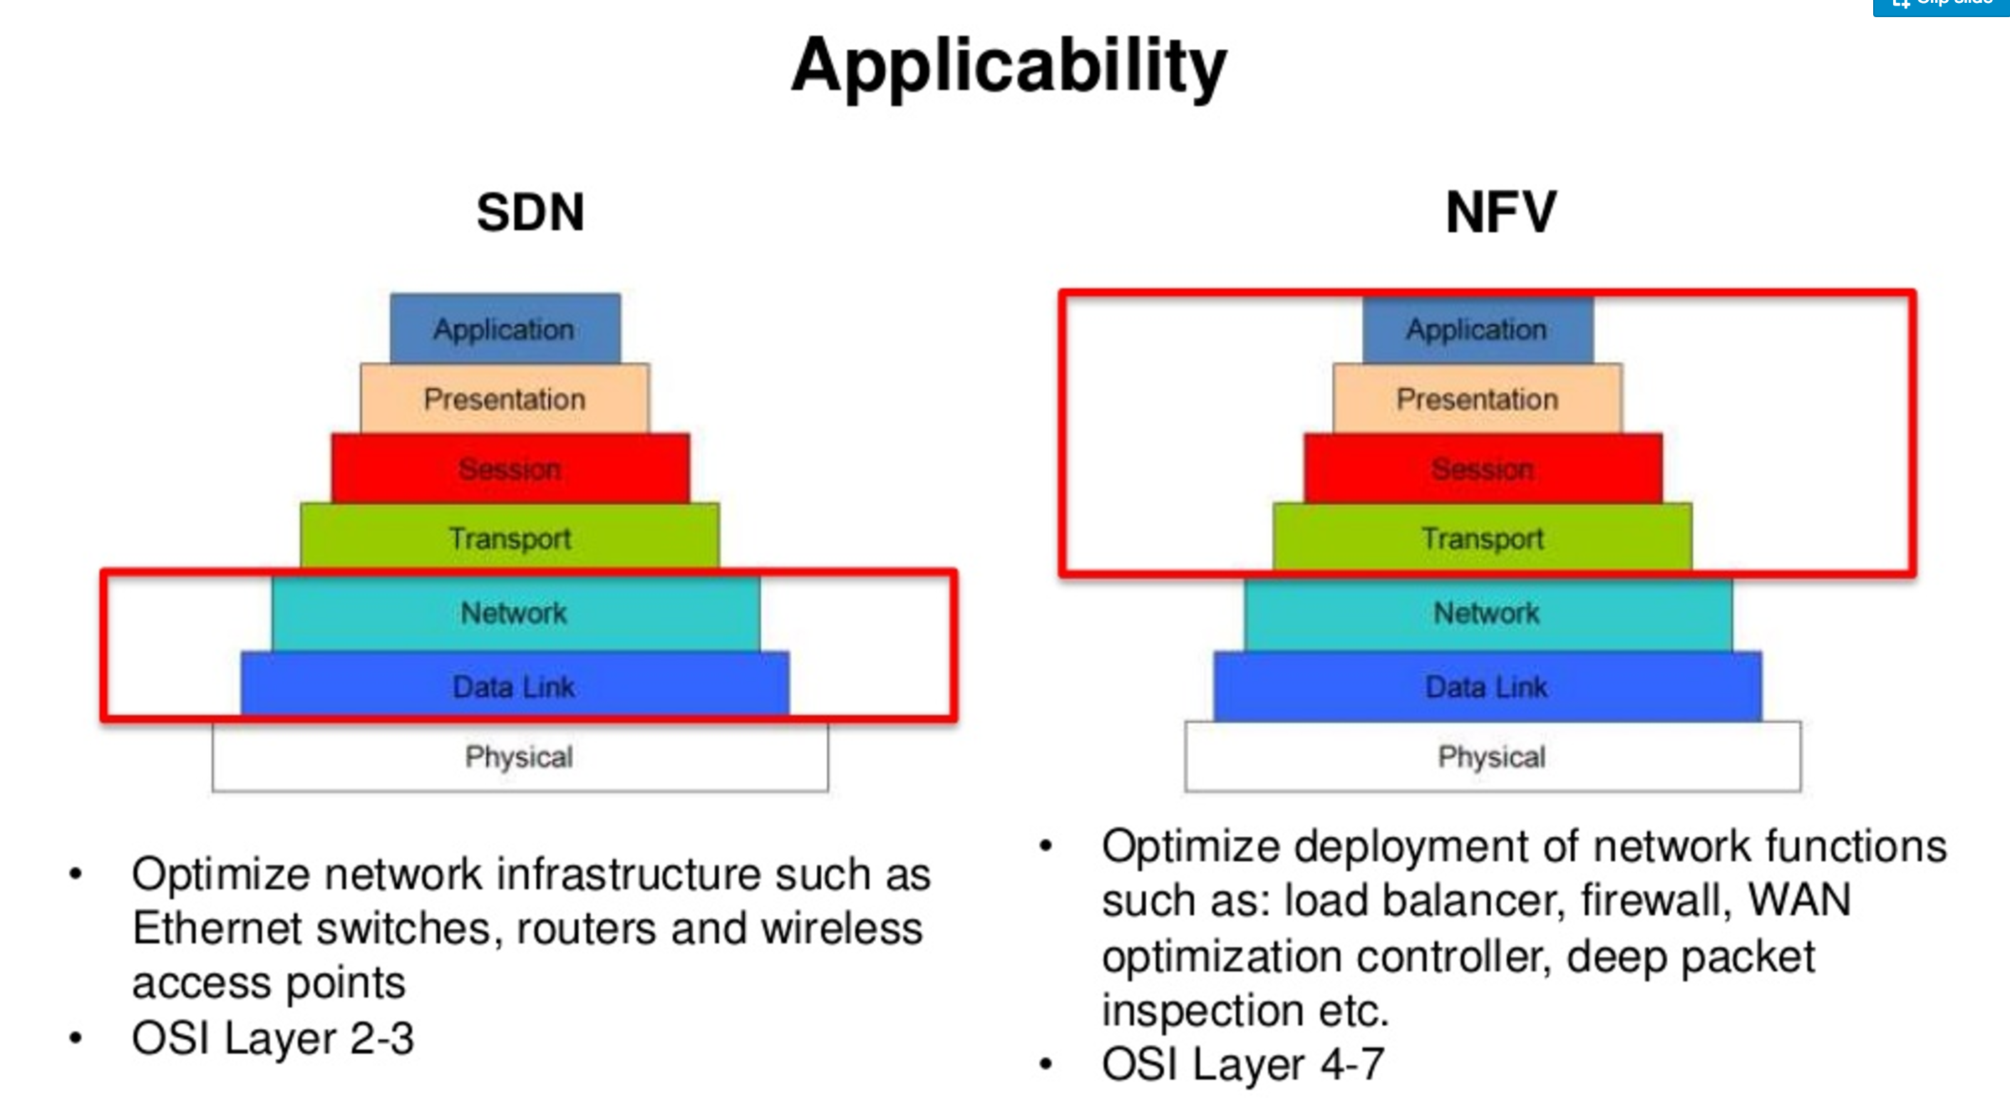
But… too many papers found
Space was too large:
WAN are complete systems
Have multiple layers (e.g. see picture)
Multiple WAN problems
Solution “Lets organize the results based on”:
Create categories of similar problems
Explore ML and non-ML solutions
Which data sets were used
Notes:
future directions to explore in Network-ML realm?

Slide 12
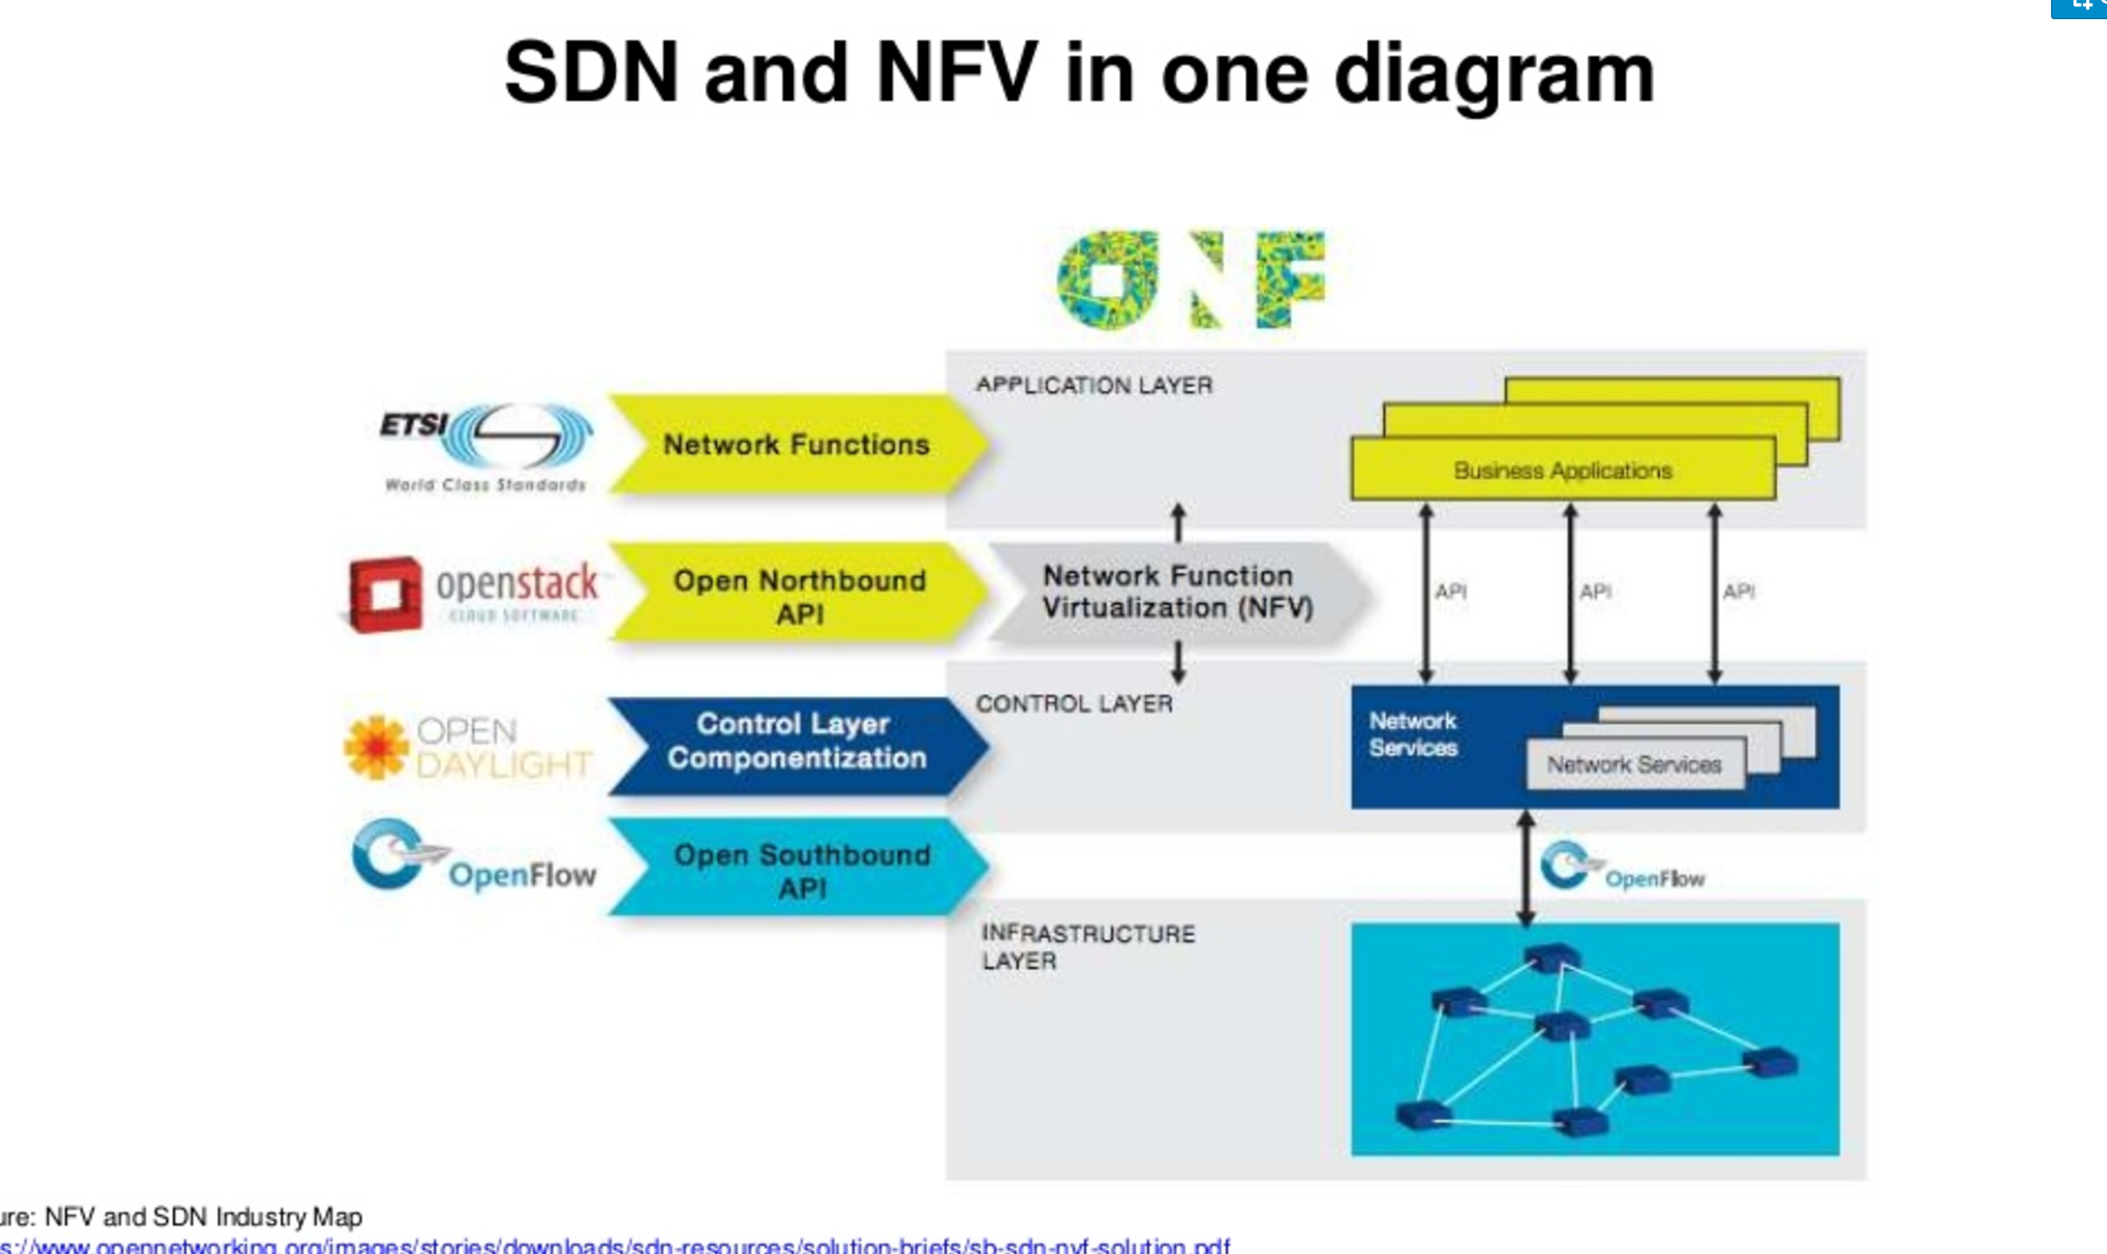
Grouping Problems into 4 Categories
User traffic data
User traffic
(directed flows)
WAN Topology
(traffic engineering)
(flow-level, traffic prediction, adaptation, path optimization, link failure)
Infrastructure traffic data
(Packet-level, queues, TCP, UDP)
Infrastructure-level modifications (Switches, deployment, etc)
12

Slide 13
1) User traffic optimization
Traffic prediction
Path optimization
Traffic adaptation
Fault finding
2) Topology Engineering
Machine learning approaches in WAN networks
3) Packet level optimizations
TCP specific problems
Scheduling, congestion
Controller placements
Actual ‘Actions’ on the WAN
4) Infrastructure optimization
Switch configurations
Multiple data center connectivity
Note: SDN related in (2, 3, 4)

Slide 14
Results

Slide 15
Relevant Papers: Statistics
Note: Google scholar gave many irrelevant results and is not regarded as a good publication search tool.
IEEE Explore
#25
ACM pub
#532
#223
#188
Web of Science
#3
Science Direct
Search additional relevance through references
Remove surveys
Apply quality assessment
#10
Remove duplications
Apply selection criteria

Slide 16
Results – per year (1)
No. of papers
Rise of ML techniques in 2017 (Workshops at SigComm, HotNets, etc)

Slide 17
Results – per category (2)
No. of papers
Non-ML still largely favored
Most ML techniques are used for classification (of traffic) and prediction (failures)
Techniques coupled with OpenFlow: Perform classification and configure packets
Some tools are enhanced by ML embedding for decision making:
Traffic awareness and security problems
Forming topologies, optimum path finding
Improve path utilizations depending on arriving traffic

Slide 18
Techniques used
 | Cat 1: User traffic analysis | Cat 2: Traffic engineering | Cat 3: Packet optimization | Cat 4: Optimize infrastructure
ML | Naïve Bayes theorem, decision trees, SVM, Random Forest, ANN | Regression and classification techniques | SVR, decision trees, naïve-bayes | Regression and classification techniques
Non-ML | Rule-based learning, statistical analysis techniques | Graph opt – min cost, greedy search, SPF | Fairness computations, path finding game theory, Markov models, simulations | Simulation, greedy algorithms for resource allocation
Classification, Regression

Slide 19
 | Cat 1: User traffic analysis | Cat 2: Traffic engineering | Cat 3: Packet optimization | Cat 4: Optimize infrastructure
Use cases | Intrusion detection Traffic profiling | Classify flows to form optimum topologies | Path performance | Optimum connections between data centers
Classification | X | X | X | X
Regression |  | X | X | X
Clustering | X
Dimension reduction
Anomaly detection | X |  | X
Feature learning
Coupling with devices |  |  |  | X
Demo using simulations

Slide 20
Data Involved
Range from packet data, path properties, IP addresses, QoS, TCP/UDP traces, etc…
E.g. Google’s B4 optimizes topology to SD WAN (based on demand, packet loss, utilization)
Use cases | Focus | Data set used
Category 3: Packet-level optimization | VM resources | Fairness schemes, MTTF, MTTR, Netflow
Category 4: Infrastructure optimization | Flow tables, controller placements | No. of jobs running, VM data, CPU usage, Application data
Notes:
A Machine Learning Approach to TCP Throughput Prediction Mariyam Mirza ; Joel Sommers ; Paul Barford ; Xiaojin Zhu Published in: IEEE/ACM Transactions on Networking
Traffic statistics collection with FleXam Sajad Shirali-Shahreza, Yashar GanjaliAugust 2014 SIGCOMM '14: Proceedings of the 2014 ACM conference on SIGCOMM
Unusual internet traffic detection at network edge Neha Bansal ; Rishabh Kaushal2015 International Conference on Computing and Network Communications (CoCoNet)

Slide 21
Road Ahead…

Slide 22

Lots of Areas still Under-developed
DQN
Reinforcement Learning Agent
Networks are mostly graph optimization problems: Applying ML techniques is unique
Identify what we want to achieve along the pipeline:
policy
π_{θ}(s, a)
State s
Take action a
parameter θ
Understanding (Classification)
Prediction
Action
Link with devices (SDN, NFV, etc), but what are the ‘knobs’ we can alter?
ML research focuses on game strategies. We don’t have similar “strategies” in networks!

Slide 23
Breaking Down – ML Blackbox
Rather than ‘One’ have multiple algorithms
Working with heterogeneous data sets – feature learning
Computational costs of data processing and model training
Using HPC/ GPU to all models to learn
Not to treat ML as a black box, but understand why

Slide 24
Conclusions
AI shows some promise: Learn, Try, Fail, Learn, Try, Succeed!
Mix of Skills: Networks + ML + HPC + (complex workflows)
Combining techniques (and algos) to advance research in explored:
New areas in network and perhaps even more
Opening and sharing data sets/techniques for research (R&E network community)
Notes:
Software and networks

Slide 25
Any questions/comments?
We are looking for postdocs, please contact…
Thankyou!
MKiran@es.net
Funded under DOE Panorama Project (2017-2019), DOE ASCR (2017-2022)

